Slide 1


welcome
To our presentation

Slide 2
Presentation On: Machine Learning for 5G future. Made by: 1. Md. Aminul Islam ID: IT-17025 2. Ansar Ali ID: IT-17041
Index:
Abstruct
Documantation section
Introduction
The three types of learning and its application in wireless communications
Potential of machine learning to support 5G requirements
Beyond 5G, emerging trends and opportunities.
Special considerations to deploy ML on 5G.
3. Applications of Machine Learning for 5G security.
4. Conclusion.

Slide 3
Abstract:
Driven by the demand to accommodate today's growing mobile traffic, 5G is designed to be a key enabler and a leading infrastructure provider in the information and communication technology industry by supporting a variety of forthcoming services with diverse requirements. Considering the ever-increasing complexity of the network, and the emergence of novel use cases such as autonomous cars, industrial automation, virtual reality, e-health, and several intelligent applications, machine learning is expected to be essential to assist in making the 5G vision conceivable. This presentation focuses on the potential solutions for 5G from an ML-perspective. First, we establish the fundamental concepts of supervised, unsupervised, and reinforcement learning, taking a look at what has been done so far in the adoption of ML in the context of mobile and wireless communication, organizing the literature in terms of the types of learning. We then discuss the promising approaches for how ML can contribute to supporting each target 5G network requirement, emphasizing its specific use cases and evaluating the impact and limitations they have on the operation of the network.

Slide 4
Documentation Section Start

Slide 5
INTRODUCTION
The continuously evolving communication network architecture to integrate diverse range of devices with unique requirements for different network parameters has resulted in sophisticated challenges for network security. The recent developments in 5G Net-works and beyond are facilitating the immersive growth of data communication by providing higher data rates and speeds. Such gigantic increase in data trafﬁc and connected devices means more vulnerabilities, threat , and attacks resulting in catastrophic damages ﬁnancially, socially and on humanity. Therefore, scrutinizing andanalysis of such Big Data for suspicious activities cannot only be achieved with traditional methods.In this context, Artiﬁcial intelligence and MachineLearning are envisioned to play a key role in solving previously considered NP-hard, and complex optimization problems. The Self-Organizing networks, intelligent and adaptive algorithms implemented in dif-ferent parts of network architecture paved the way for use of AI and ML with even higher performance gains at smaller costs.

Slide 6
The Three Types of Learning and its Application in Wireless Communications
The presentation is divided according to the level of supervision that the ML procedure requires on the training stage. The major categories discussed in the following sections are supervised, unsupervised, and reinforcement learning . To understand the difference between these three learning subcategories, a quintessential concept of “learning” can be invoked: “A computer program is said to learn from experience E with respect to some class of tasks T and performance measure P, if its performance at tasks in T, as measured by P, improves with experience E” . Supervised learning comprises looking at several examples of a random vector x and its label value of vector y , then learning to predict y from a completely new x , by estimating p(y|x ), or particular properties of that distribution. Unsupervised learning implicates observing different instances of a random vector x and aiming to learn the probability distribution p(x ), or its properties. Reinforcement learning comprises an agent interacting with an environment, and getting feedback loops between the learning system and its experiences, in terms of rewards and penalties

Slide 7
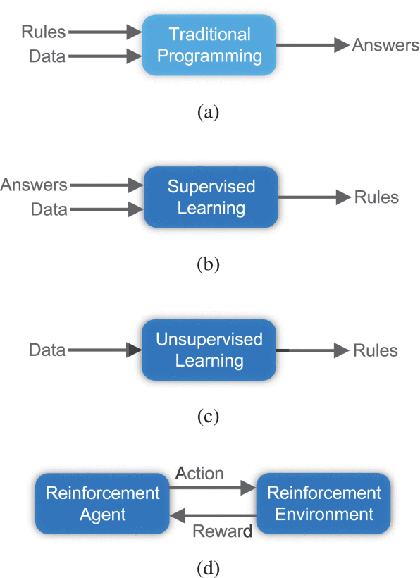
FIGURE : Traditional programming compared to the three types of machine learning. (a) Traditional programming, (b) supervised learning, (c) unsupervised learning, and (d) reinforcement learning.

Slide 8
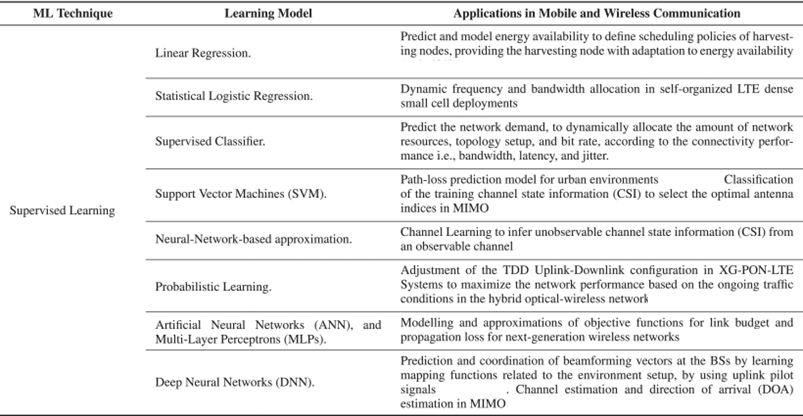
Supervised Learning in 5G Mobile and Wireless Communications Technology

Slide 9
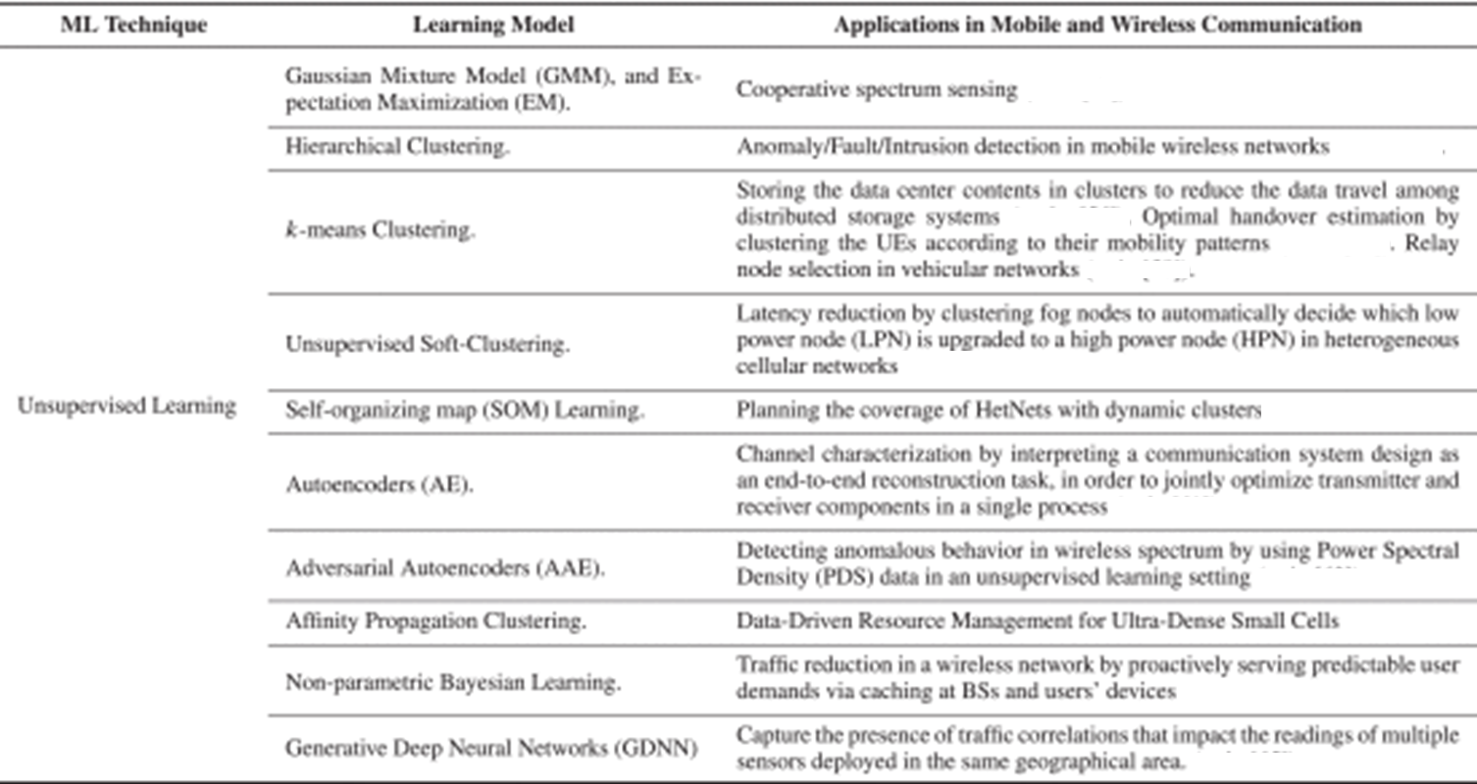
Unsupervised Learning in 5G Mobile and Wireless Communications Technology

Slide 10
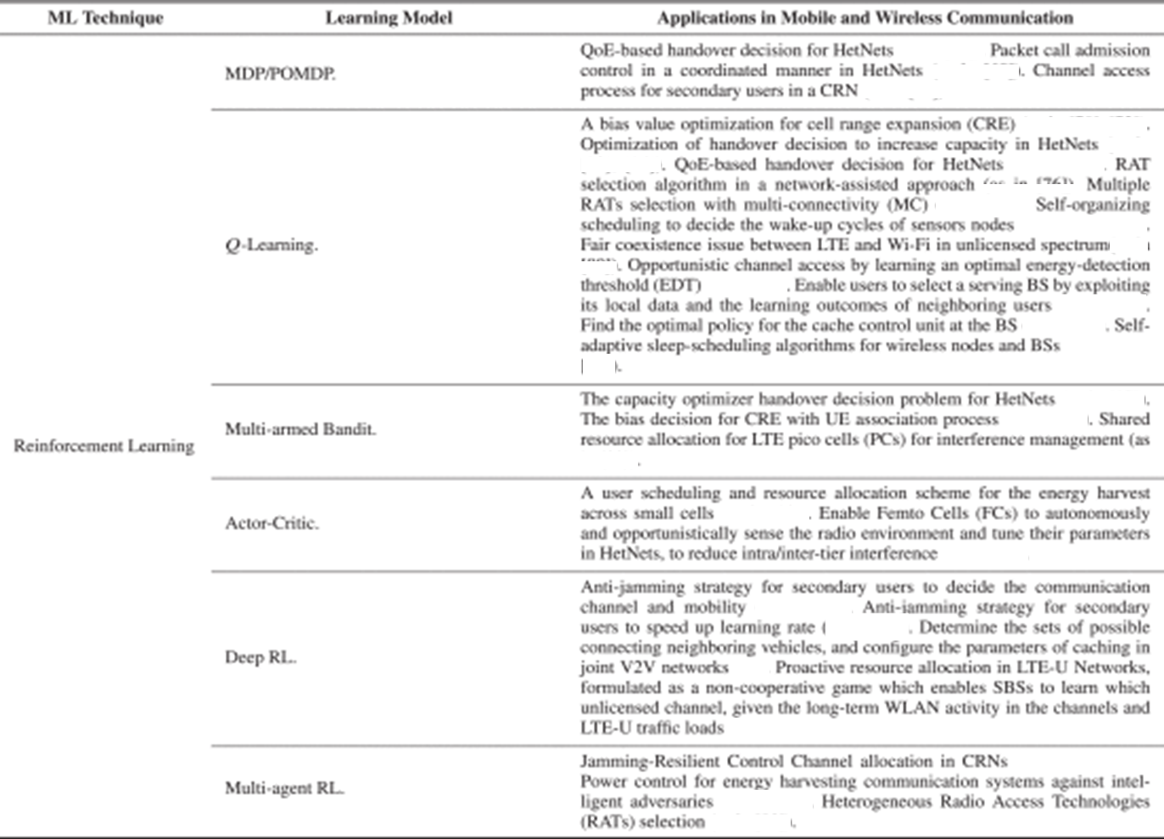
Reinforcement Learning in 5G Mobile and Wireless Communications Technology

Slide 11
iii. Potential of Machine Learning to Support 5G Requirements
In this section, we look at the road to the next generation network deployment, and explore the link between ML algorithms and 5G requirements . 5G is not an incremental improvement over 4G, but rather the next major evolution of mobile communication with performance improvements of several orders of magnitude over IMT-advanced. The intent of these requirements is to ensure that IMT-2020 guarantees more flexibility, security, and reliability than previous technologies, providing a variety of services and deployment scenarios for a wide range of environments . By agreeing on these requirements, relevant parties (e.g., network operators, manufacturers, regulators, etc.) can work towards developing the same system, where their own particular needs may not be met at the moment. In this section, we have grouped the main 5G requirements into three generic communication services and have studied how ML can assist in reaching their demands. Each service emphasizes a different subset of requirements and applications related to some extent. The three generic services are:

Slide 12
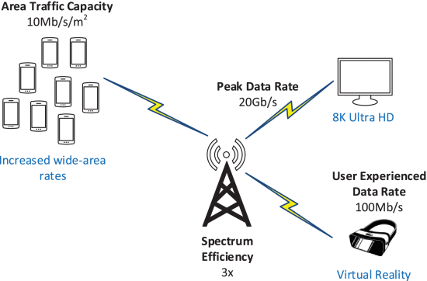
Enhanced Mobile Broadband (eMBB)
Enhancing the current MBB service will enable new applications with higher data rate demands over a uniform coverage area (e.g., ultra-high definition video streaming, and virtual reality) The essential requirements to enable eMBB are presented below:

Slide 13
1) Peak Data Rate
Peak data rate is planned to increase and support high-demand data-driven use cases. IMT-2020 systems will be required to deliver 20-times higher data rate than the previous technology specification, from 1 Gb/s in 4G to 20 Gb/s in 5G.
2) User Experienced Data Rate
User experienced data rate is defined as the 5% point of the cumulative distribution function (CDF) of the user throughput over active time (i.e., the number of correctly received bits at MAC Layer 3), measured in a dense urban environment. IMT-2020 intends to brace 10-times higher user experienced data rate compared to 4G LTE, from 10 Mbit/s to 100 Mbit/s. Its strong connection with other requirements such as peak data rate and latency makes it ideal to be used as a 5G performance indicator in real-world environments.
3) Area Traffic Capacity
Area traffic capacity refers to the total traffic throughput served per geographic area in Mbit/s/m2, that is, the number of correctly received bits contained in the service data unit (SDU), over a certain period of time. The target value for area traffic capacity increased from 0.1 Mbits/s/m2 on IMT-advanced, to 10 Mbit/s/m2 in 5G.

Slide 14
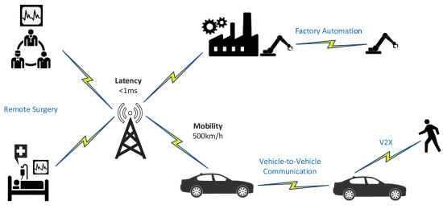
C. Ultra-Reliable Low-Latency Communications (URLLC)
Forthcoming network services, e.g., connected healthcare, remote surgery, mission-critical applications, autonomous driving, vehicle-to-vehicle (V2V) communications, high-speed train connectivity, and smart industry applications, will prioritize extreme reliability, low-latency, and mobility, over data rates . The crucial requirements to enable URLL communications are:

Slide 15
IV. Beyond 5G, Emerging Trends and Opportunities
While 5G is being rolled out in different parts of the world, Beyond 5G systems (B5G) have gained significant interest and several research projects have recently started exploring B5G or the sixth generation (6G) systems . In this section, considering the promising features of B5G, the contributions of ML are investigated for B5G. In B5G, the emergence of multi-service communication is expected. As opposed to the fixed service categorization into eMBB, mMTC, uRLLC classes in 5G, some applications in B5G may demand dynamic and/or multiple service-type allocation . For the services in fixed categories, they are expected to be sophisticated, increasing the network complexity. While the reliability and latency requirements in 6G could be use case specific, the most extreme values could be 10−9 and 0.1 ms, respectively, corresponding to the requirements in Industry 4.0 applications . For the device density, 3D connectivity will be an important consideration . With the 5G requirement of a million devices per km2, the network is anticipated to support about 10 devices per m2 and 100 devices per m3 in 6G . In terms of energy efficiency, authors in expect that 6G will support ultra-long battery life to remove the need of carrying charging devices. Considering the ever-increasing network complexity and emergence of multi-service applications, it would be essential to enhance the network intelligence to realize self-organizing features.

Slide 16
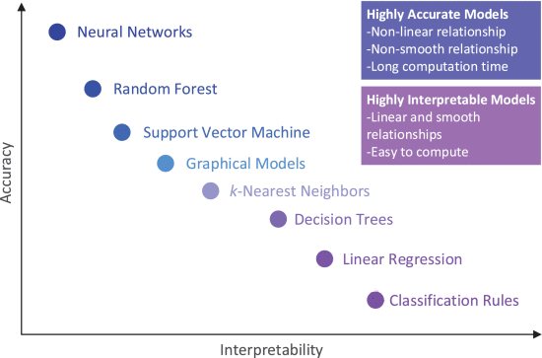
V. Special Considerations to Deploy ML on 5G and B5g
Bringing ML into 5G production incurs a unique set of challenges that needs to be addressed and understood before starting any project or research. Even though a full outline of the concerns in ML is beyond the scope.

Slide 17
Conclusion
We have seen that there is enough promise in the value of ML to dream of and experiment
with, a future in which ML can be an inherent element of wireless communications. However, for adopting ML in 5G/B5G, it is needed to consider that ML cannot be applied everywhere, bearing in mind that the costliness, time, latency, and delay introduced from some ML techniques are far from some real-time applications. ML and 5G have a lot of room to improve together as a discipline, and until the major telecommunication industry fully trusts ML, the rate of development in the area will be significantly constrained by the need to be meticulous and not break the current systems. Because ML could add uncertainty and complication to any network, our passion must be tempered by extreme caution. It is important for future researchers to make a critical evaluation of the trade-off between increasing the accuracy of a wireless system using an ML-based approach and the interpretability of the model, especially for applications in which regulatory requirements come into play.

Slide 18
Thank you

